Slide 1
Phresco Testing Framework
Automation Tool – UI Automation for iPhone Applications

Slide 2
Agenda
Basic Introduction to UI Automation
Supported devices/versions
Pre-requisites and Environment setup
Folder structure followed in Phresco
Sample Test case creation
Achievements

Slide 3
What is UI Automation?
Is an Apple's Framework which can be used to perform automated tests on real devices and iPhone Simulator
Enables users to quickly track regressions and performance issues, and also develop new features without worrying to break the app.

Slide 4
Supported Versions/Languages/OS
Supported by Java Script
Can be run in MAC only
Tests can be run on both
    simulator and
    device(iPhone and iPad)
Supported by Xcode 4.2 & above versions
Supported by Simulator 4.3 and above only

Slide 5
Pre-requisites
Xcode 4.2 or above has to be installed
Download location:
https://developer.apple.com/downloads/index.action?name=Xcode#

Slide 6
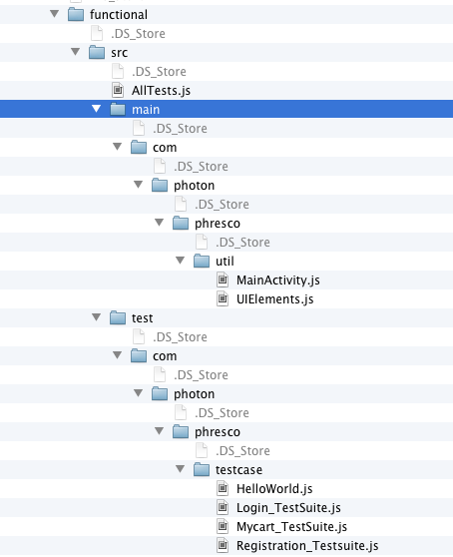
Functional test folder structure
Test suite
To maintain common methods
To maintain constants
Test cases

Slide 7
Steps to Write a Test
Deploy the app
Open Instruments and choose the target
Record the test to get the id's
Create testcases/testsuites
1. Re-Usable Methods :Common methods will be defined in MainActivity.js file under
/src/main/com/photon/phresco/util directory
2. Constant Declaration/Raw Data : Constants will be maintained in UIElements.js file under
/src/main/com/photon/phresco/util directory
3. Testcases : All the Junit Testcases will be maintained under /tes/com/photon/phresco/testcase directory
4. TestSuite creation : Testsuites and testcases will be maintained under /src/ directory
Execute your test case

Slide 8
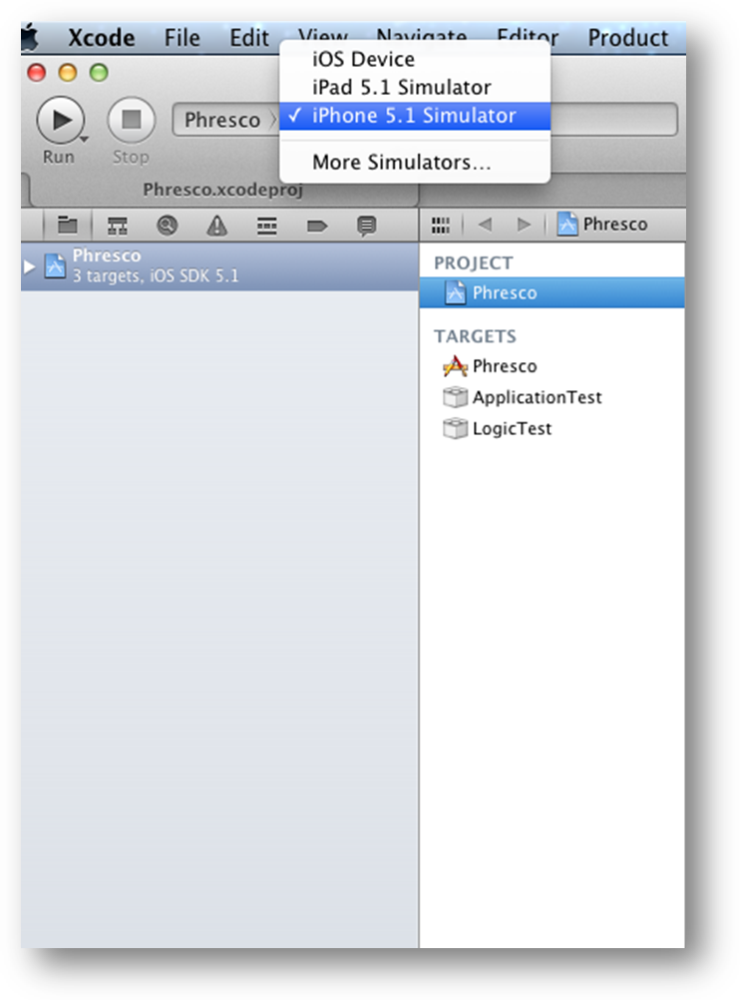
Deploy the App
1.Select the Xcode project-->Choose the
instrument to be tested as shown
2. Click “Run” to deploy the app
Note : Your App will get deployed in the path:
Users/Name/Library/Developer/Xcode/Deriveddata/App_name/Build/Products/Debug-iPhone Simulator/ “App_NAme.app”

Slide 9
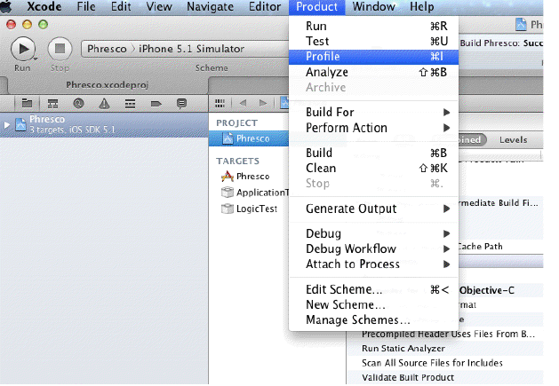
Open Instrument

Slide 10
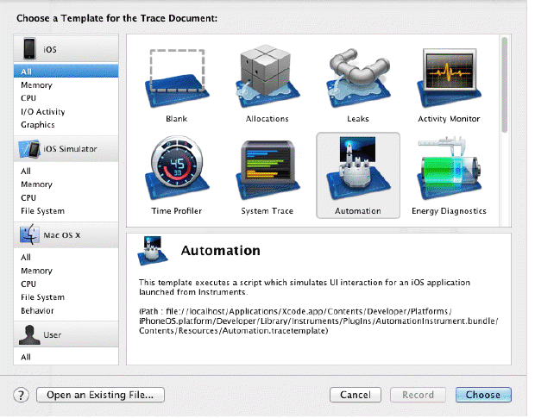
Open Instrument - (Contd)

Slide 11
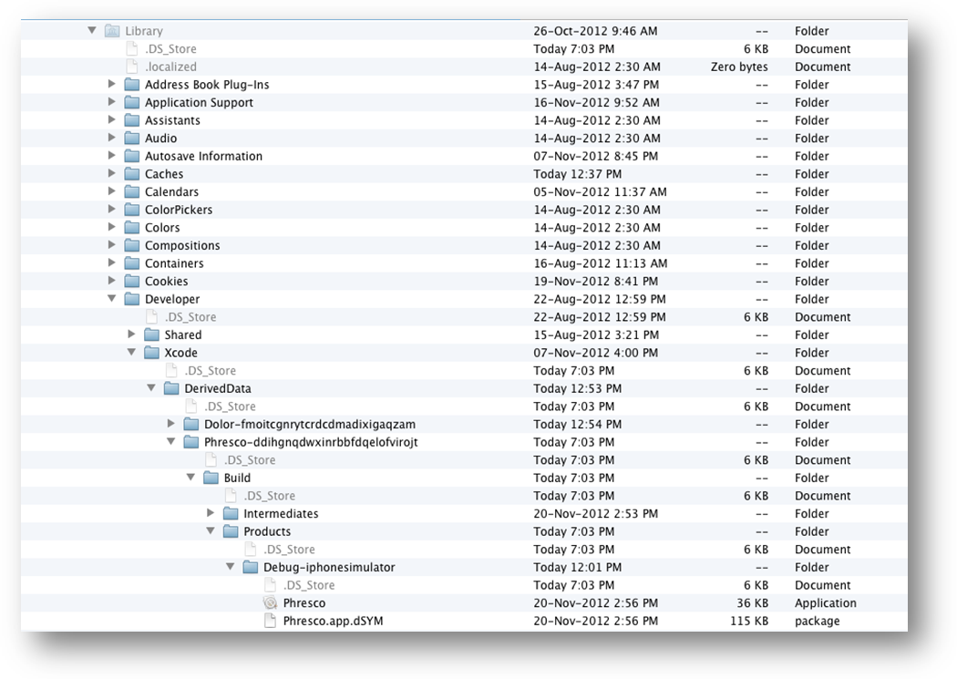
Choose Target
Your App will get deployed in the path:
Users/Name/Library/Developer/Xcode/Deriveddata/App_name/Build/Products/Debug-iPhone Simulator/ “App_NAme.app”

Slide 12
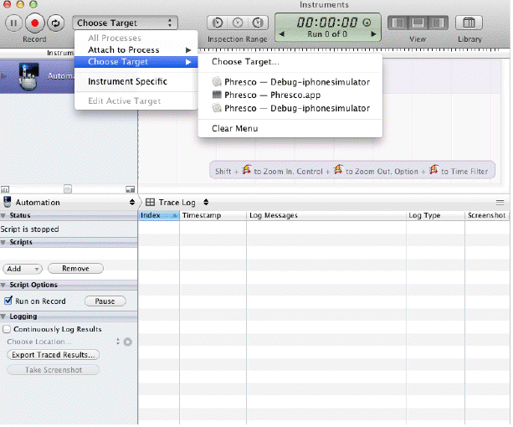
Choose Target - (Contd)
Choose the “Target” for which the test has to be done

Slide 13
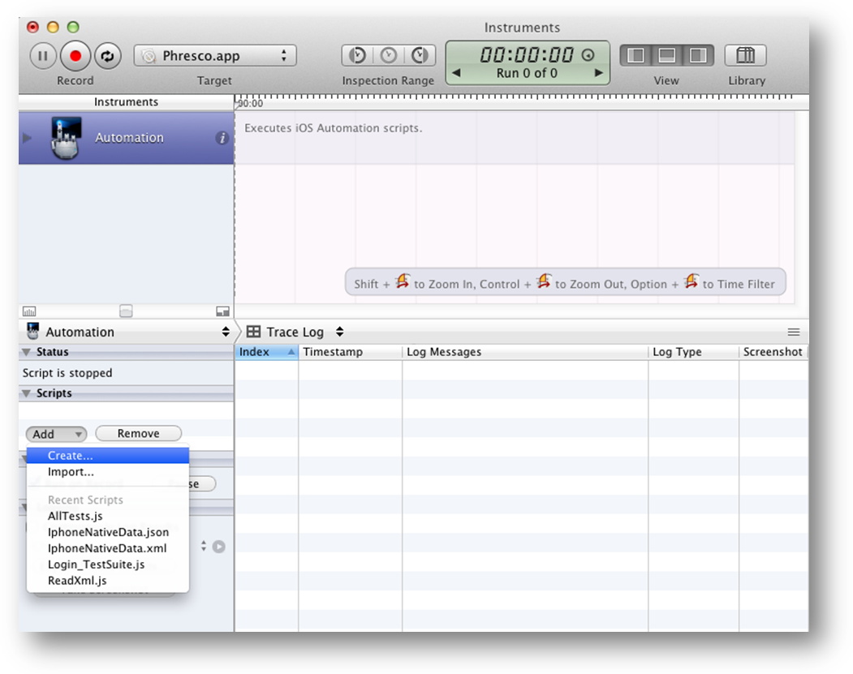
Creating a Sample testcase
Click Add-->Create

Slide 14
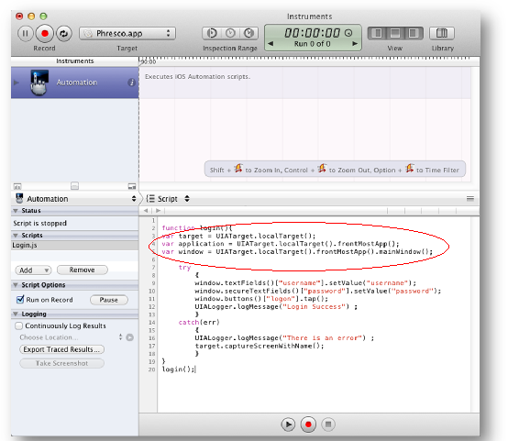
Creating a Sample testcase - Contd
Add the highlighted lines of code to the newly created js file
Once added, click “Record” button to record the tests

Slide 15
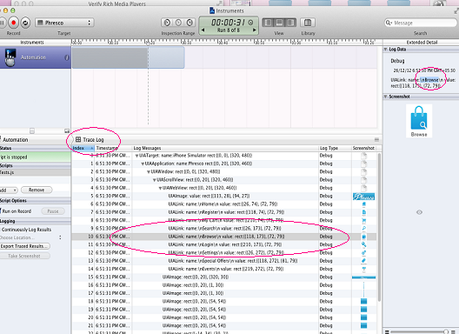
Capturing ID's
Click on “Trace Log” to see the captured ID's

Slide 16
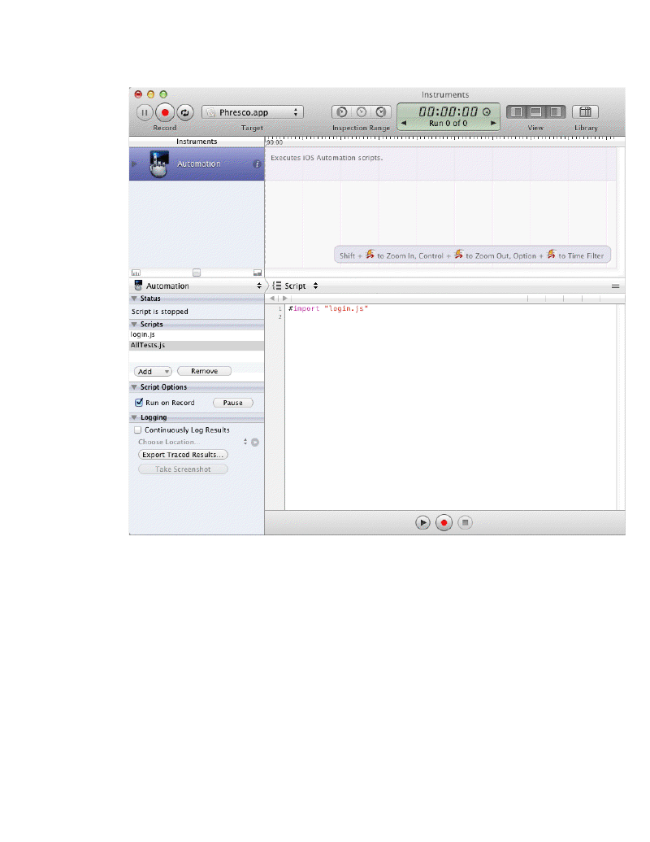
Creating a Test suite
Click Add-->Create-->AllTest.js

Slide 17
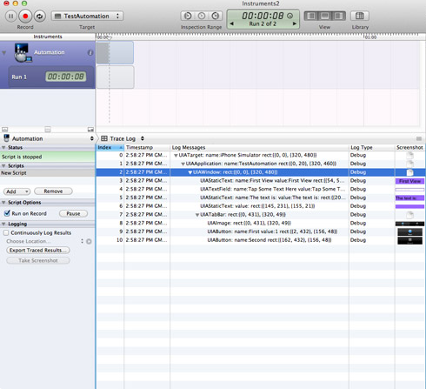
Executing Test – in Simulator
Execute the script - ⌘R

Slide 18
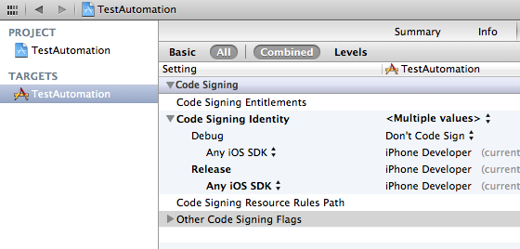
Executing Test – in Device
Connect your iPhone to USB
Select the scheme ’TestAutomation > iOS Device
Check that the Release configuration is associated with a Developer profile
Profile the app (⌘I)
Follow the same steps than previously on the Simulator.

Slide 19
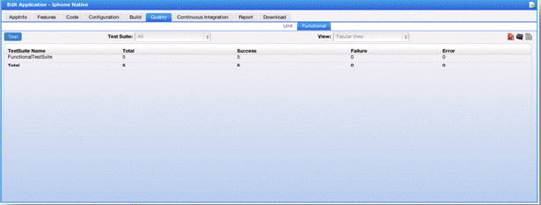
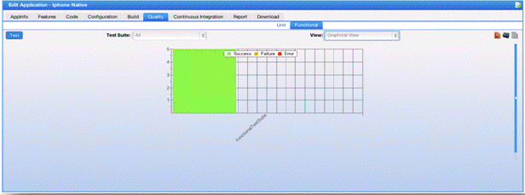
Report Generation in Phresco- Success
Report

Slide 20
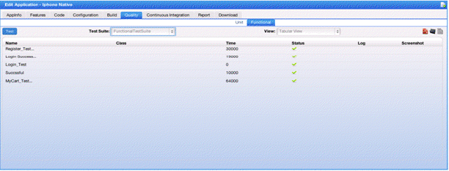
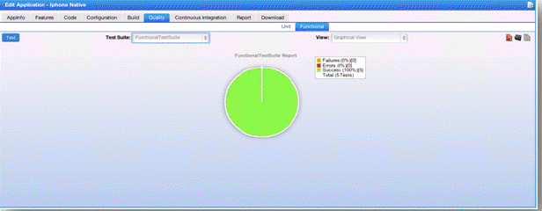
Success Report - Continued

Slide 21
Achievements
Phresco QA team has written automation test scripts for few accounts like
  L’Oreal(Makeup.com),
  JnJ(Zyrtec,Mobility…)
  Walgreens(Loyalty)
  Bestbuy(PDTS,DigitalDeals..)
  SSBT(CRA,BPC,IVL,SRE,DGF)
  NBO1(MyTouchtunes,Karaoke)
  VWR(Widget and Android applications)
  NetSmart,
  HorizonBlue(Corporate Website)

Slide 22
Q & A
For queries, contact phresco-support@photoninfotech.net

